Slide 1
JOURNEY SCRAPBOOK
CUSTOM TRAINING
04-09-2023 to 08-09-2023
Purushottam Behera
Batch-5

Slide 2
Agenda week-3
Azure Storage Type
Azure Storage Account and Azure Data Factory
Azure Data Factory – 1 (Hands on)
Azure Data Factory – 2 (Hands on)
Azure Data Factory – 3 (Hands on)

Slide 3
Day – 1 (AZURE STORAGE TYPE)
SERVICES IN AZURE TO STORE DATA:
Blobs
Queues
Tables
Files
TYPES OF AZURE STORAGE ACCOUNTS:
Azure Blob Storage
Azure Gen1 Storage
Azure Gen2 - Data Lake
Redundancy in different storage types: GRS,ZRS,LRS
Managing and Monitoring the Stored account:
Using Metrics
and Alerts
Demo regarding the Azure Storage account Service.

Slide 4
Day – 2 (Azure Storage Type (Hands On) & Azure Data Factory)
Introduction to Azure Data Factory.
Discussion on concepts like Azure Active Directory, architecture of the storage account.
Data Factory's orchestration capabilities enable you to design and automate complex data workflows, making it easier to transform and process data as it flows through your organization
Creation of the Azure resource group, storage account , Azure Storage account containers , Azure Data Factory etc using Azure CLI.

Slide 5
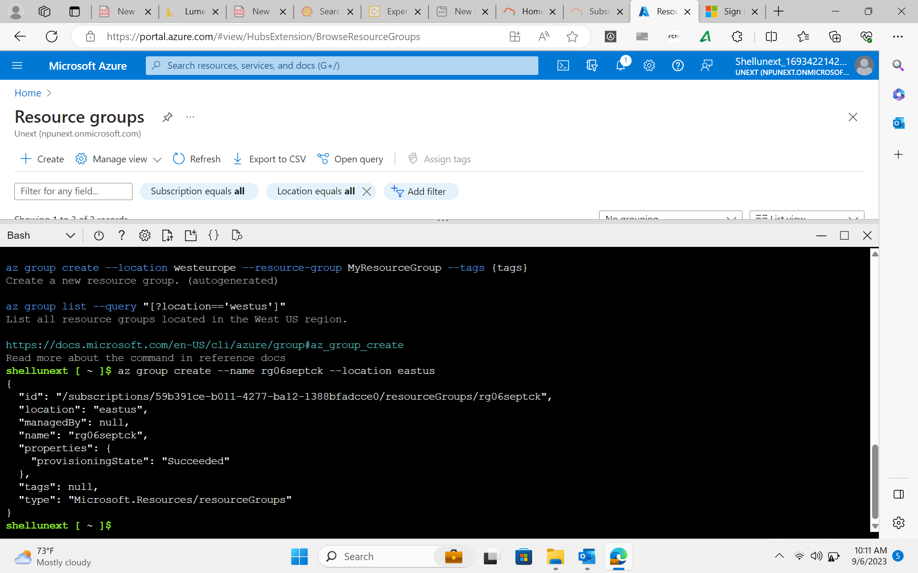
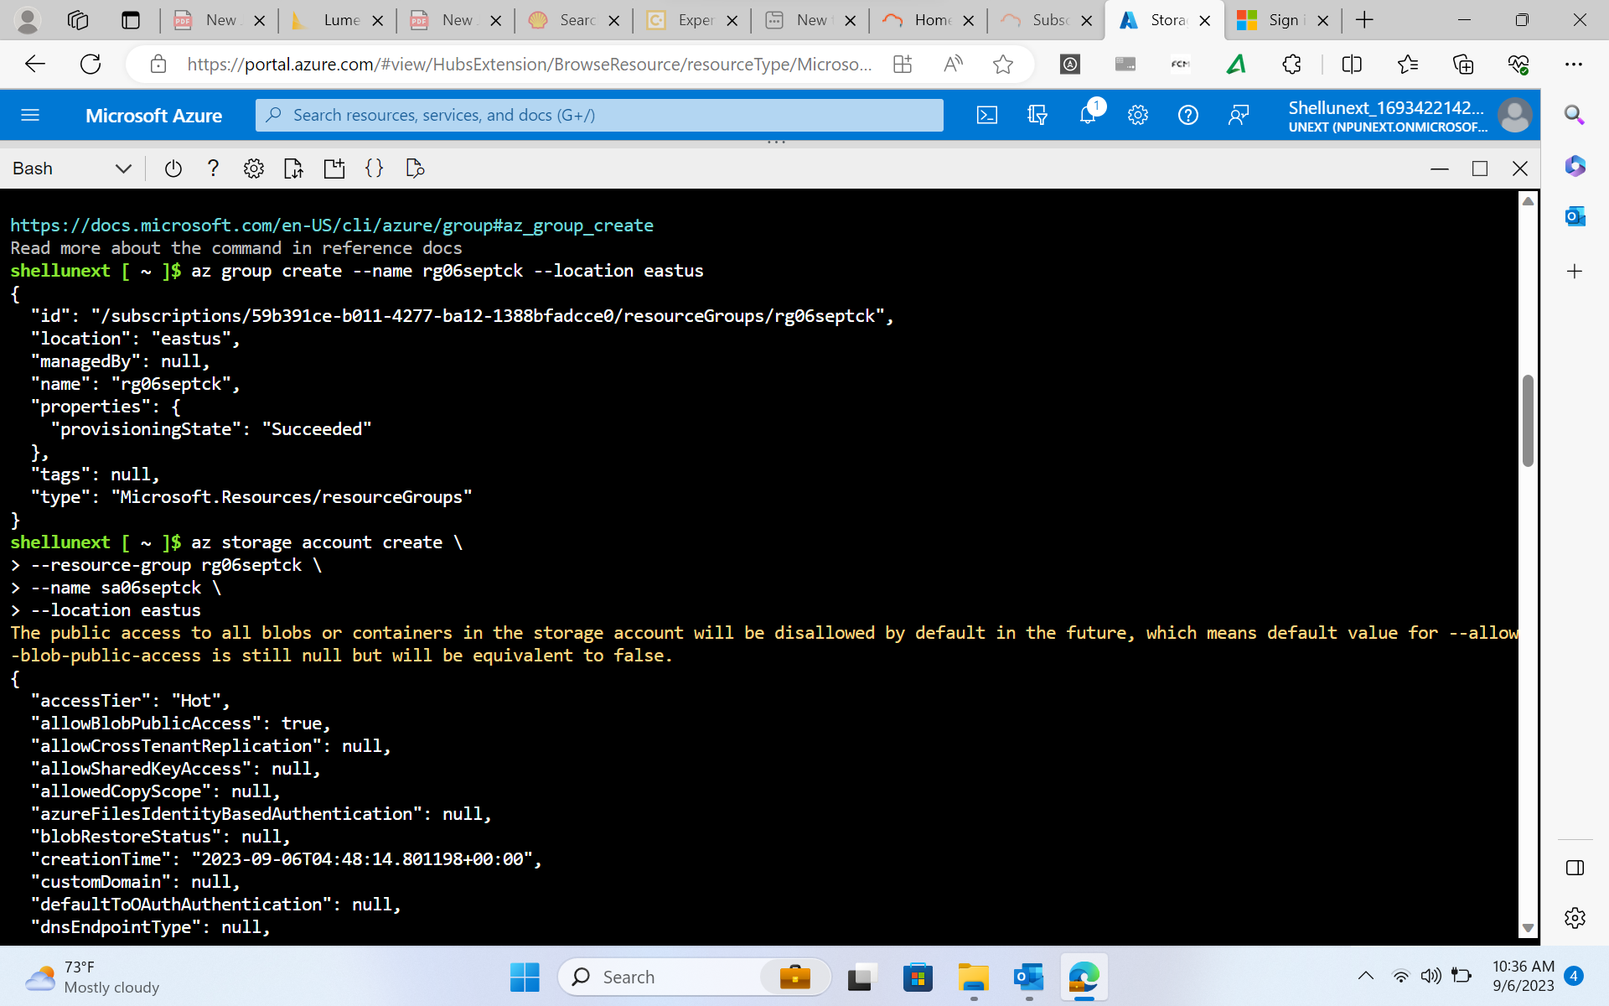
Day – 2 ( continued… )
Resource group and Storage account creation using Azure CLI

Slide 6
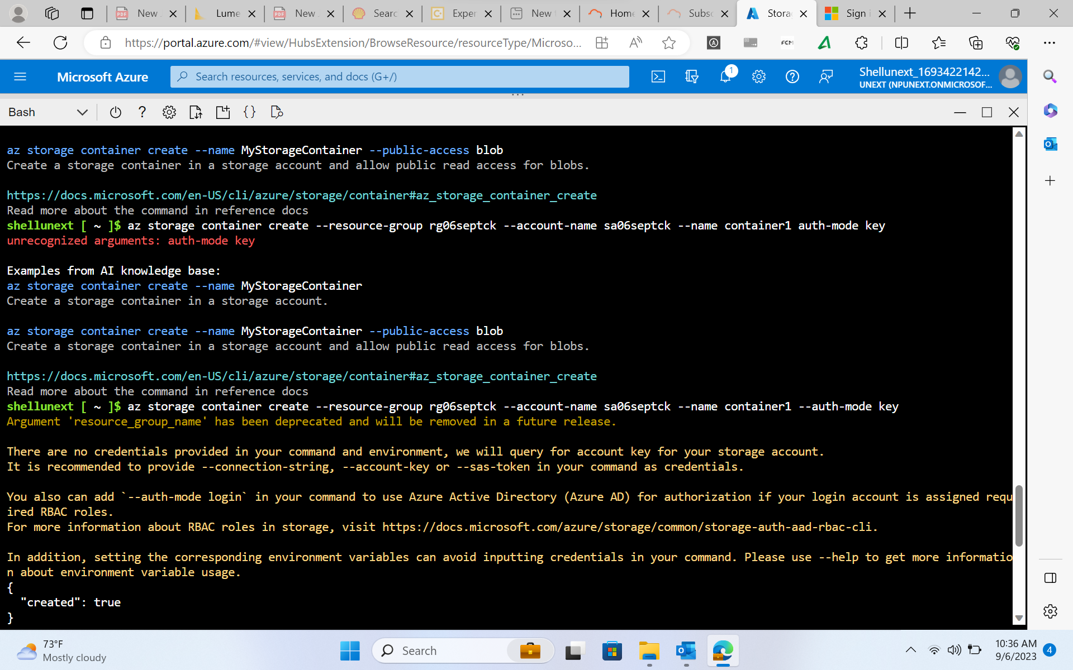
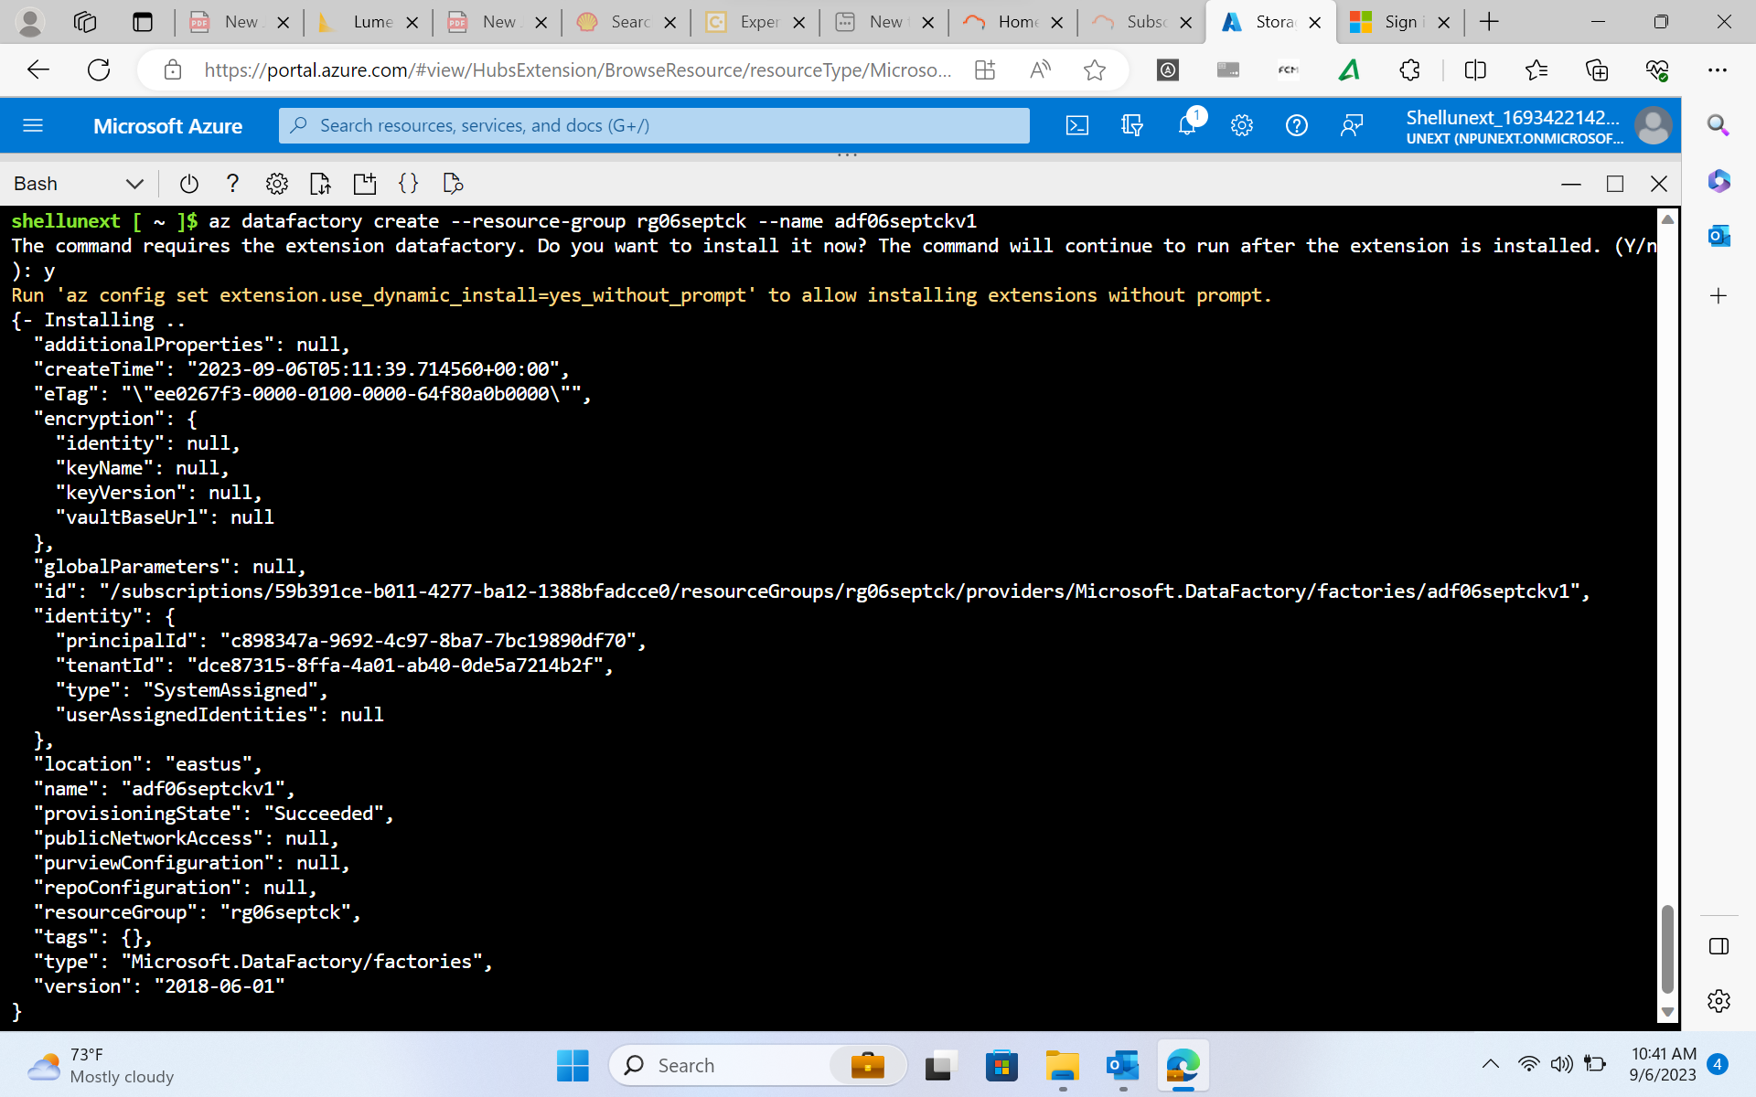
Day – 2 ( continued… )
Creation of Containers and data factory using Azure CLI

Slide 7
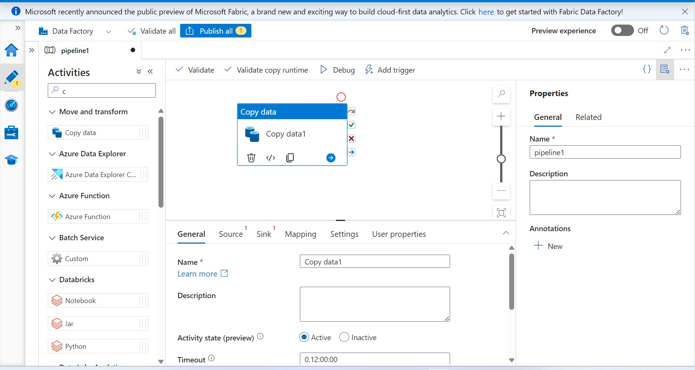
Day – 3 ( Azure Data Factory – 1 )
Copy Data activity using Azure Data Factory i.e., fetching the data from one container of the Azure storage account to another container that is output with the concept of the Azure Linked Service.

Slide 8
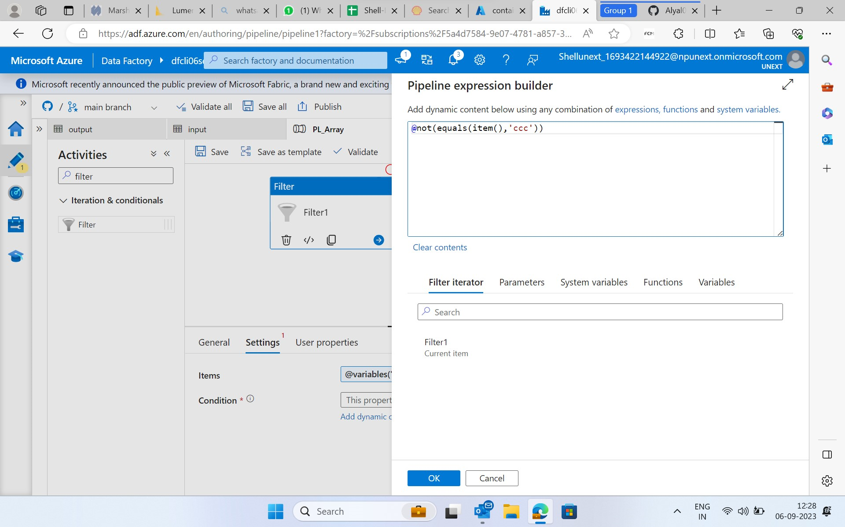
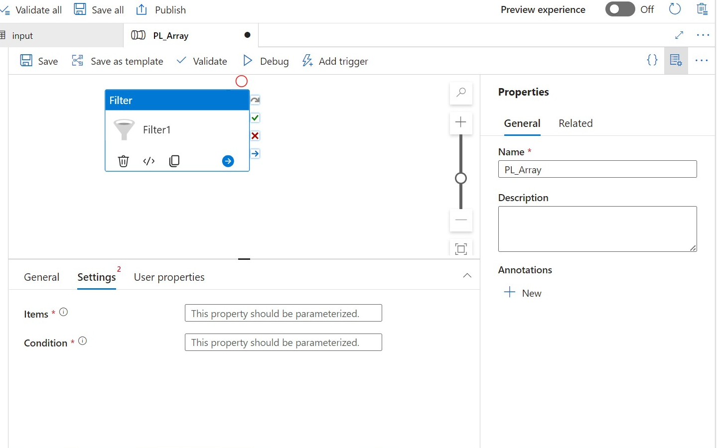
Day – 3 (continued… )
Demonstration of use of filter on the given dataset
Executing a condition using Azure Pipeline Expression builder which is a functionality of the Filter activity

Slide 9
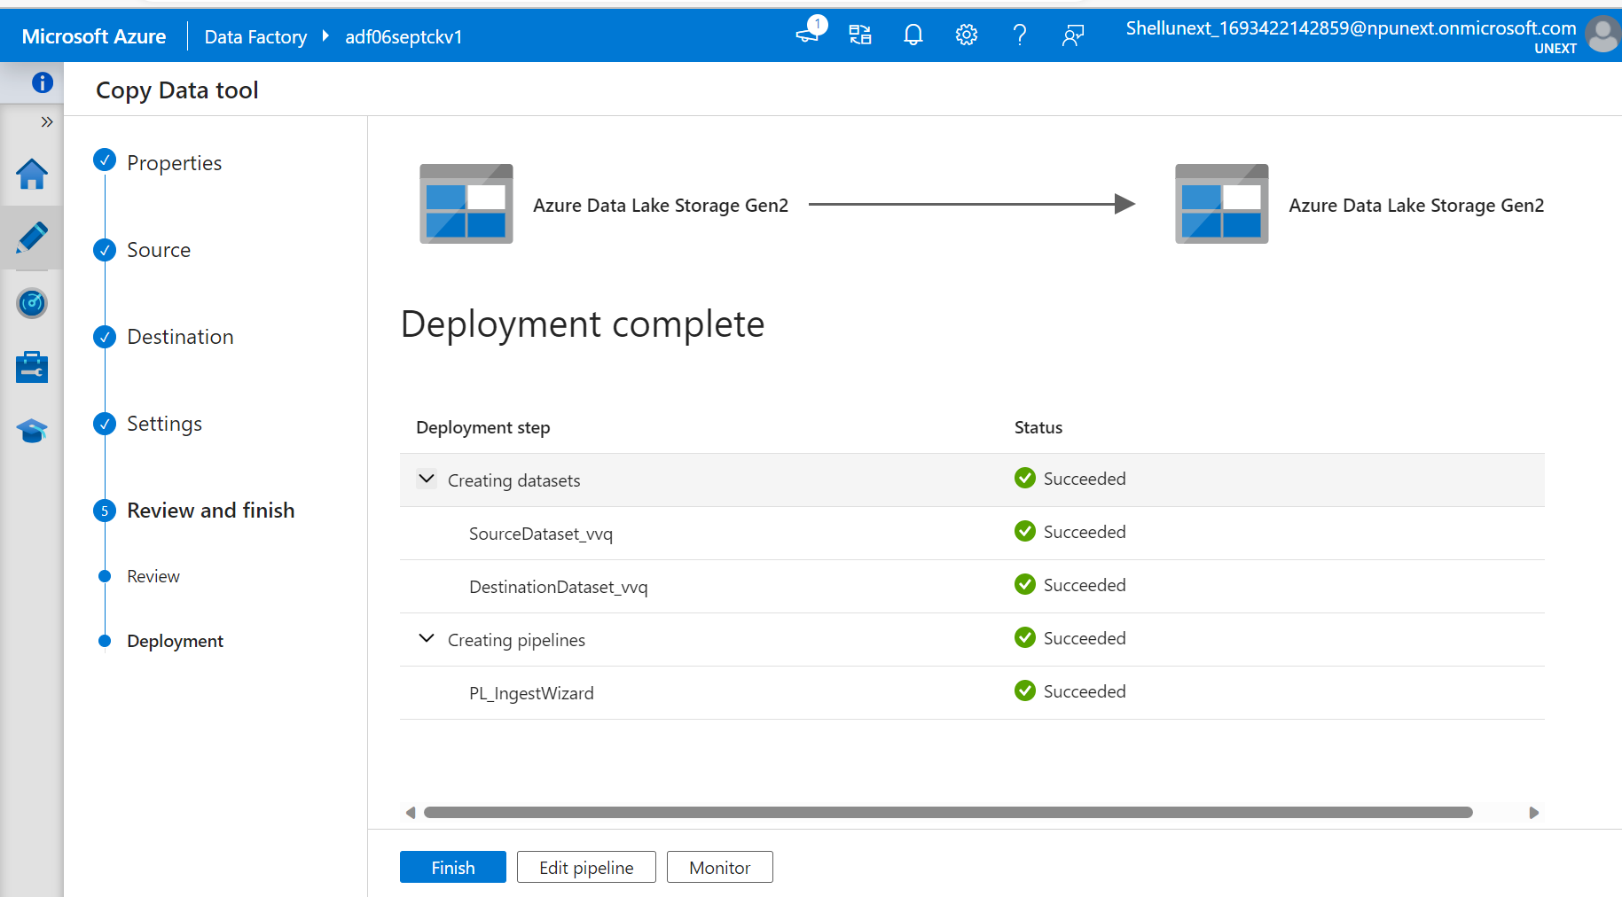
Day – 3 (continued… )
An alternative way to perform copy data activity using Ingest Functionality of the DataFactory.

Slide 10
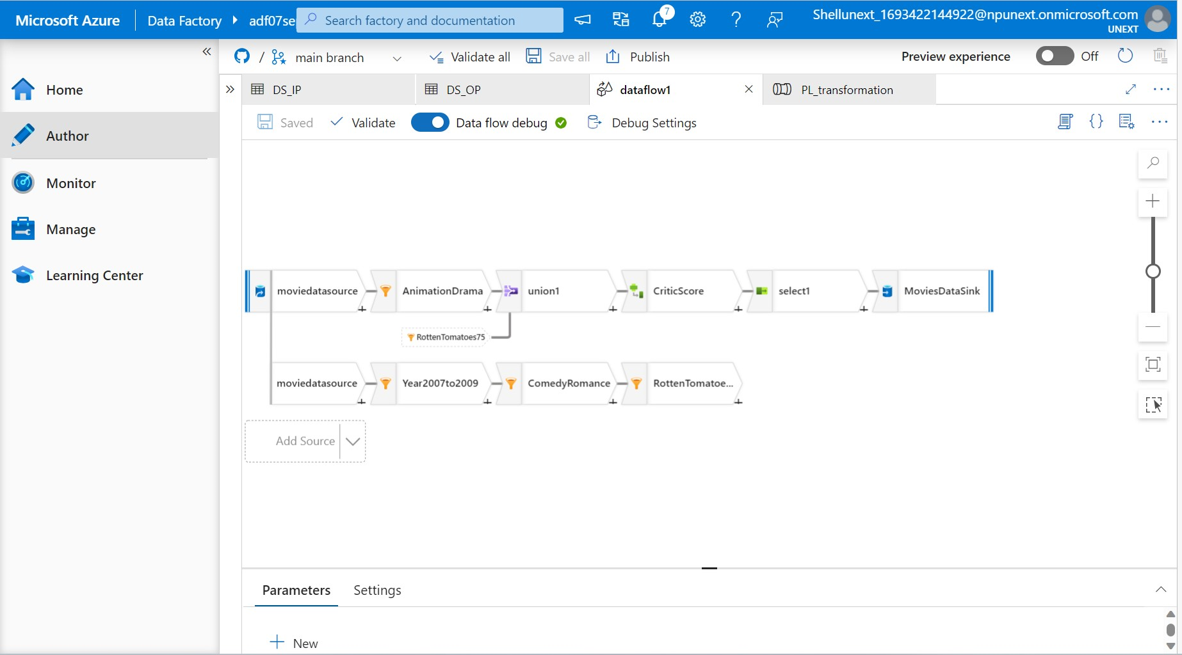
Day – 4 ( Azure Data Factory – 2)
Introduction to Data Flow which allowed us to form many data related activities like filtering , changing the value of the particular data point, performing conditional operations, making new columns
Making DataFlow pipeline architecture using Filters , branching, union operations, making a new column using “Derived Column” Feature

Slide 11
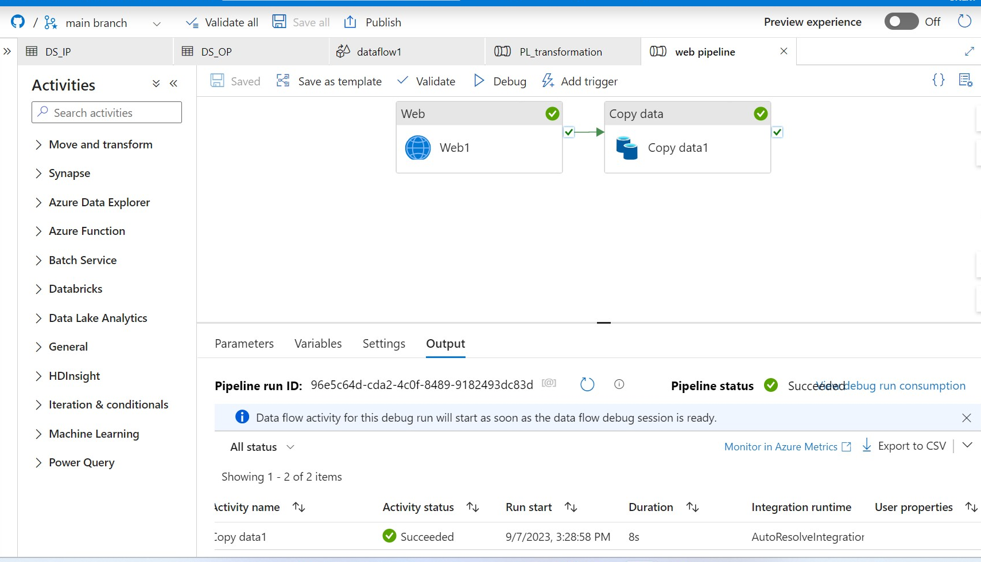
Day – 4 ( continued… )
This activity involved fetching the data from the provided website using ‘REST’, ’http’ linked resource of Azure Data Factory and then performed the copy data activity to put the data into the output container storage account as json file and then converting that to the csv format.

Slide 12
Day - 5 (Azure Data Factory – 3)
1. Copy data activity from SQL Database to a container in Storage account
Steps to follow:
Resource group creation
Storage account creation
Input container
Output container
Azure Data factory creation
Creation of Azure SQL Database
Pipeline creation with Copy Data activity to save data in output container
Azure Data Factory
SQL Database
Storage Account

Slide 13
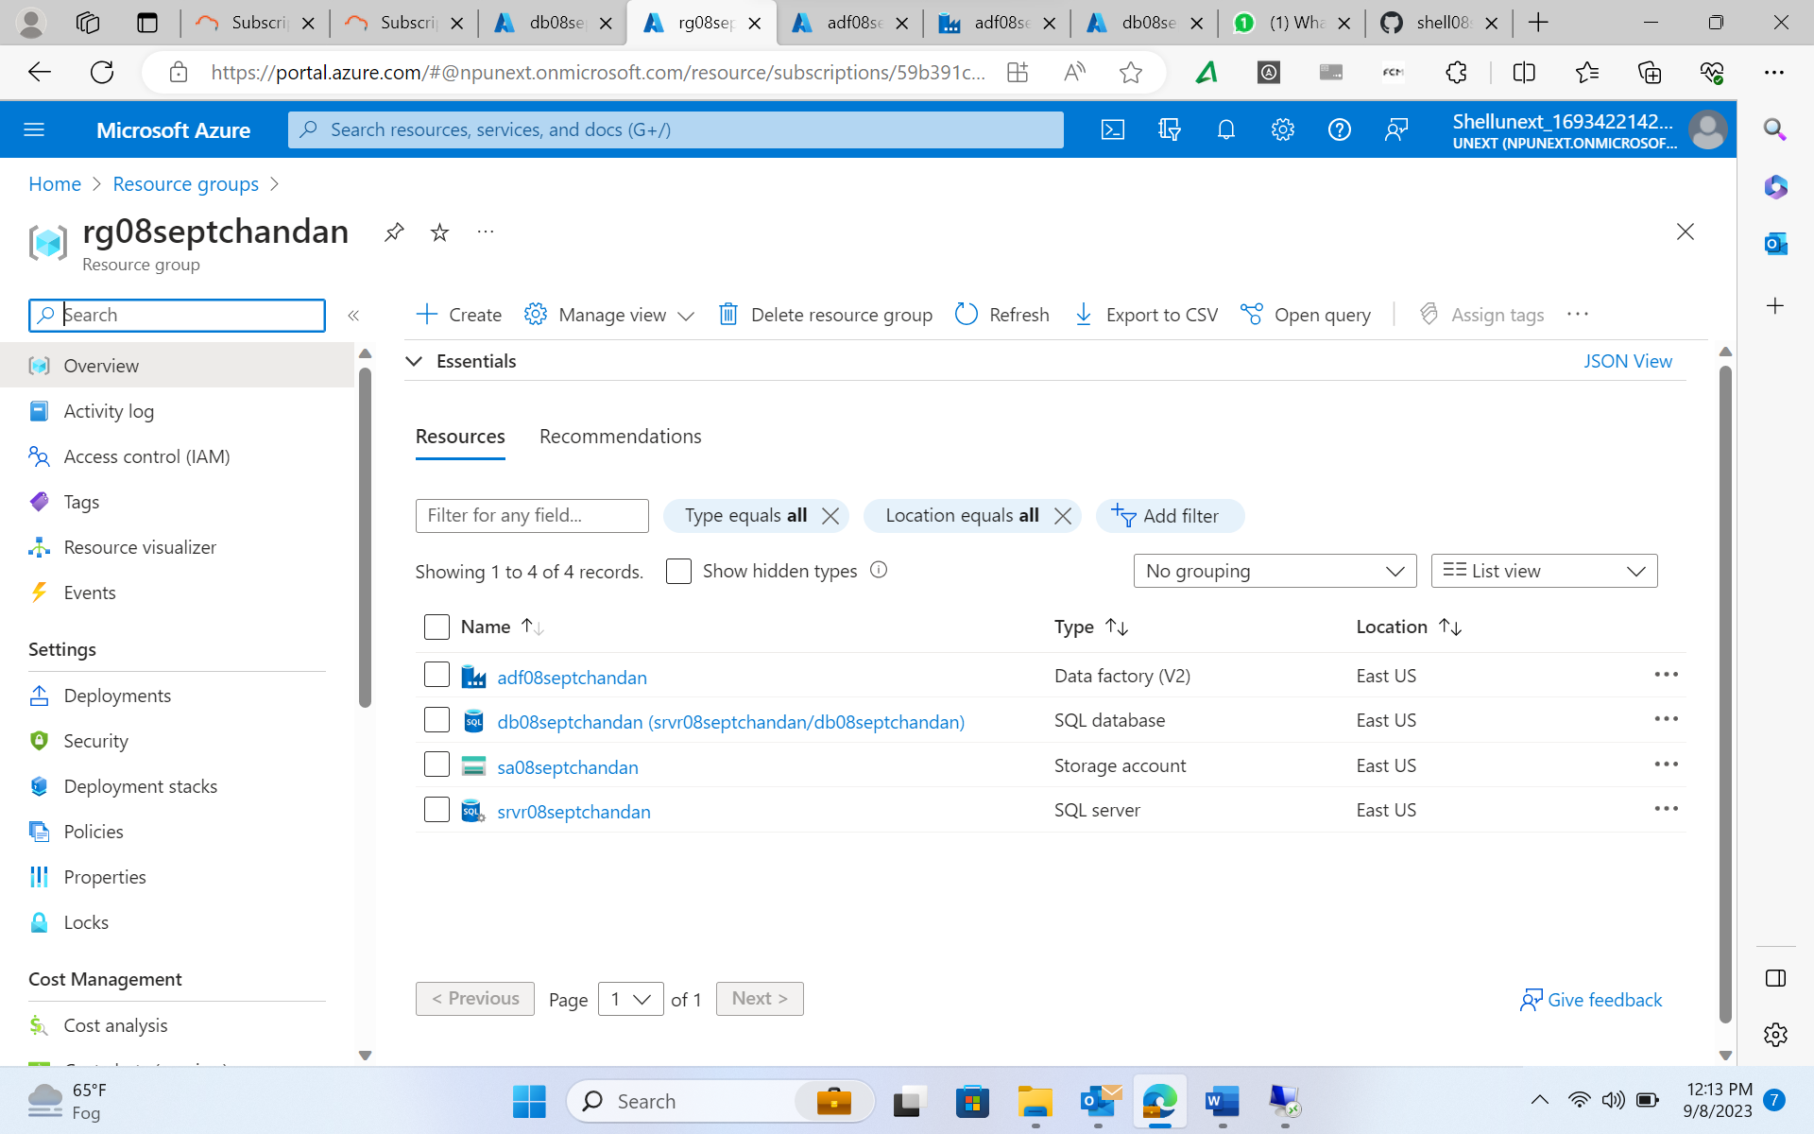
Day - 5 ( continued… )
Resource group created along with all the resources required for the activity

Slide 14
Day - 5 ( continued… )
Azure SQL Database Creation
Using the following config:
Basics:
- SQL Server
o Server name: server name
o Authentication mode: sql authentication (username, password)
- Database
o Name
o Workload env: dev
Networking
- Network connectivity
o Connectivity method: public endpoint
- Firewall rules
o Allow Azure services and resources to access this server - yes
o Allow Azure services and resources to access this server – yes

Slide 15
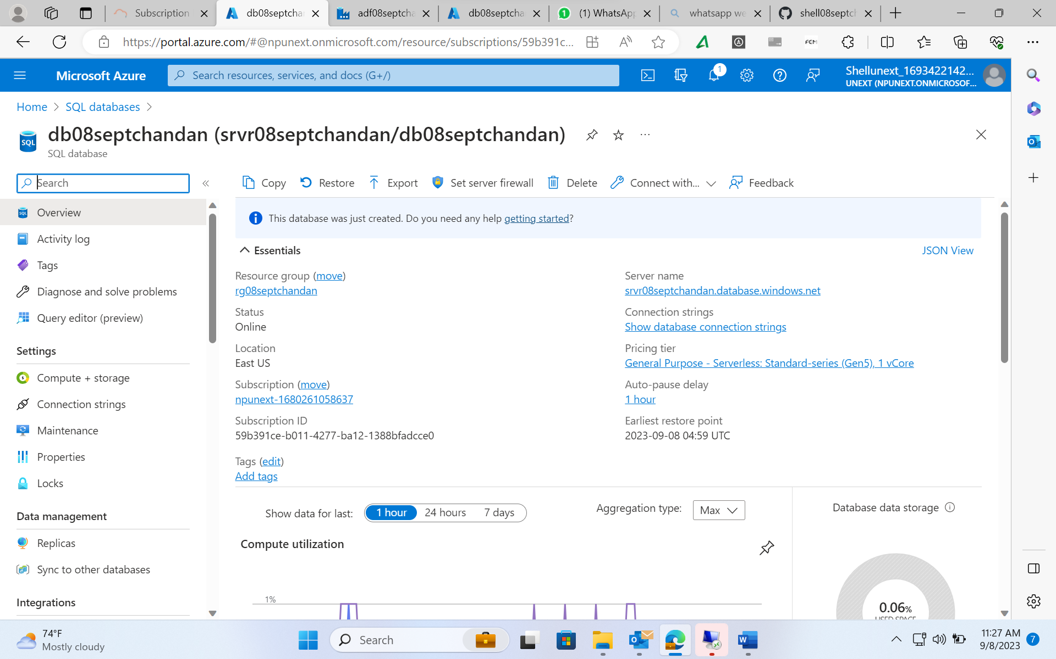
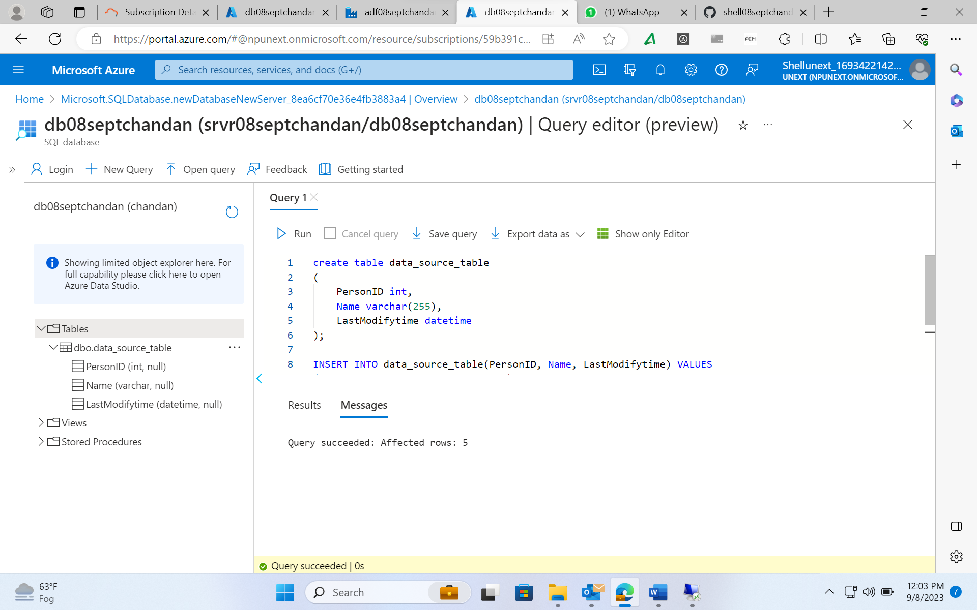
Day - 5 ( continued… )
After creating SQL Database service
Connecting the SQL Database using web client such as query editor

Slide 16
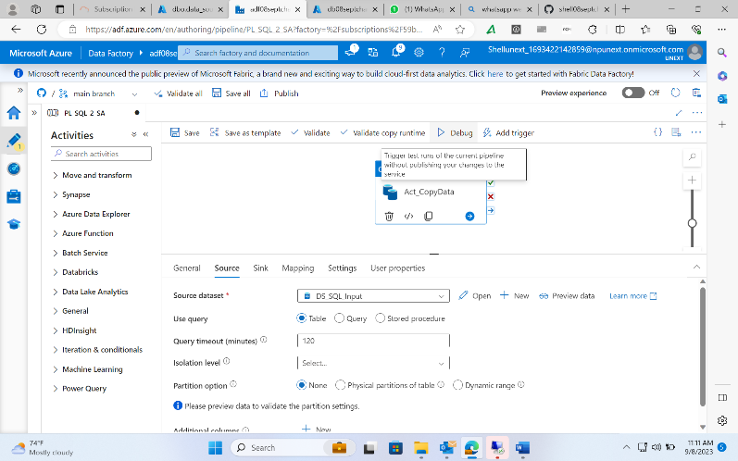
Day - 5 ( continued… )
Pipeline creation and configuring the copy data activity properties such as source and sink:
Source – SQL dataset
Sink – Storage Account dataset

Slide 17
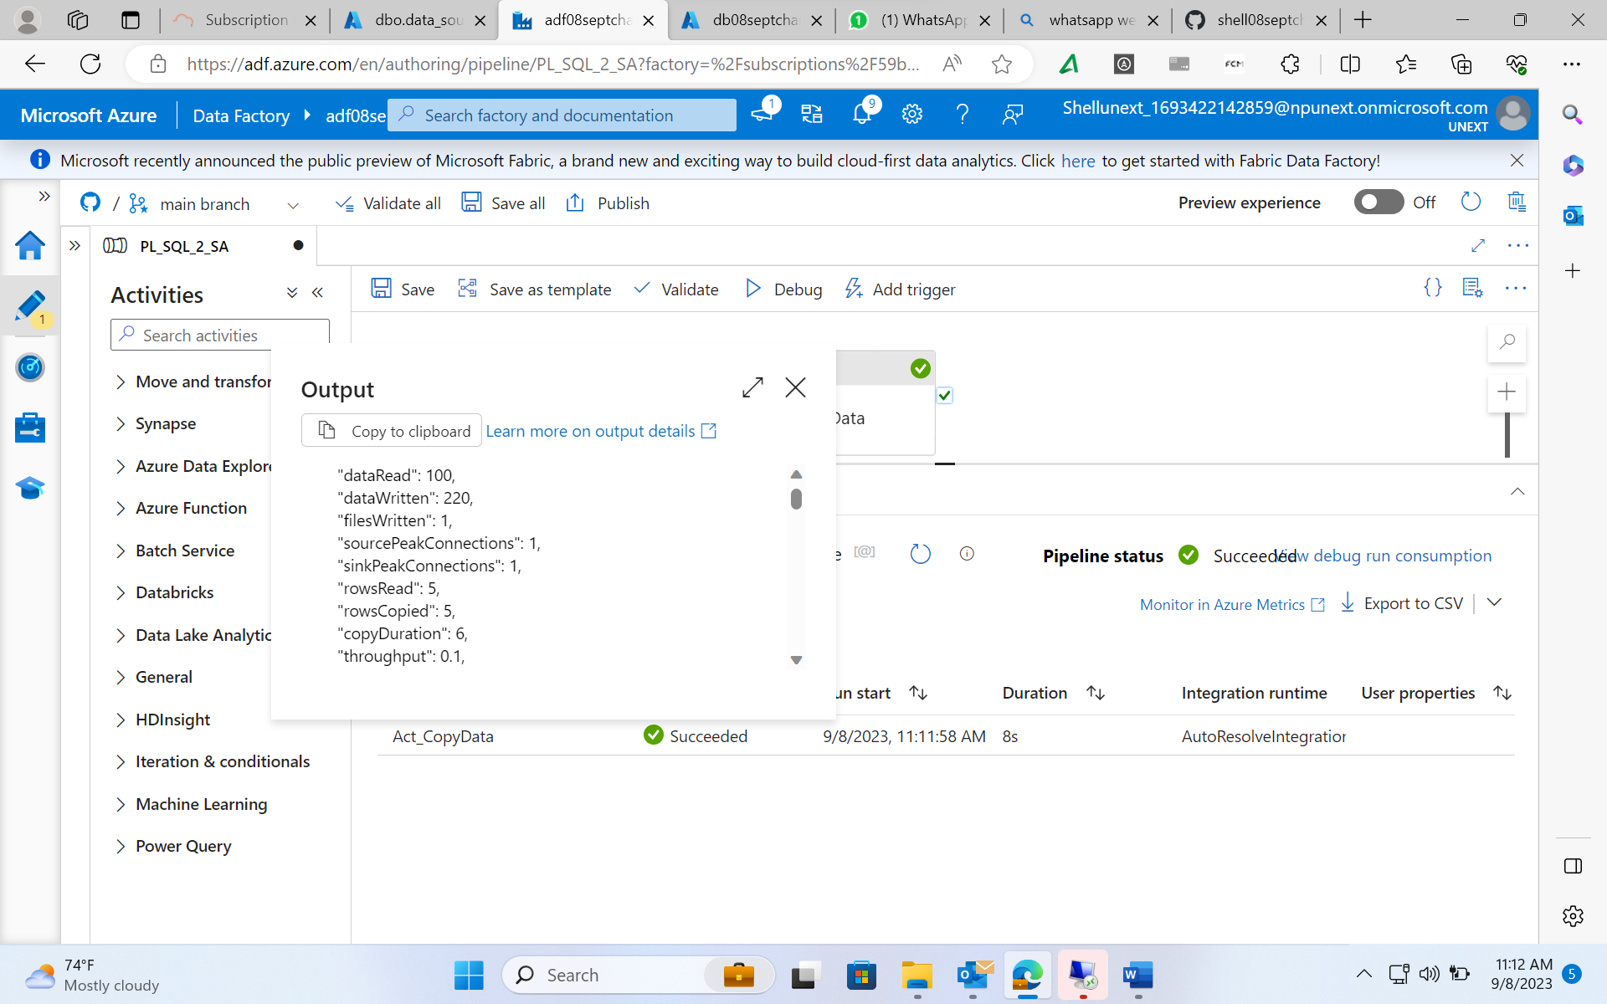
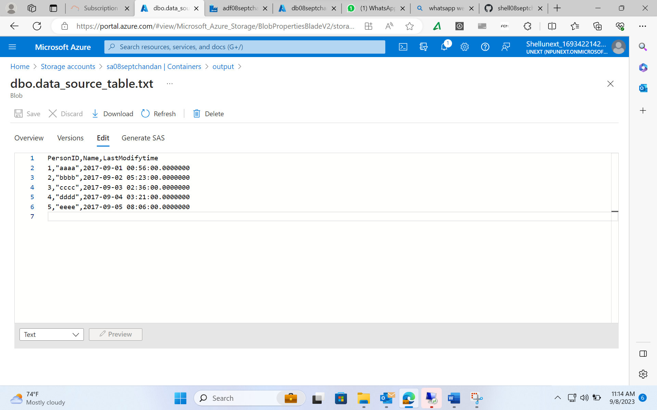
Day - 5 ( continued… )
Output of running the pipeline
On completion of Pipeline a copy of SQL Data gets stored in the container

Slide 18
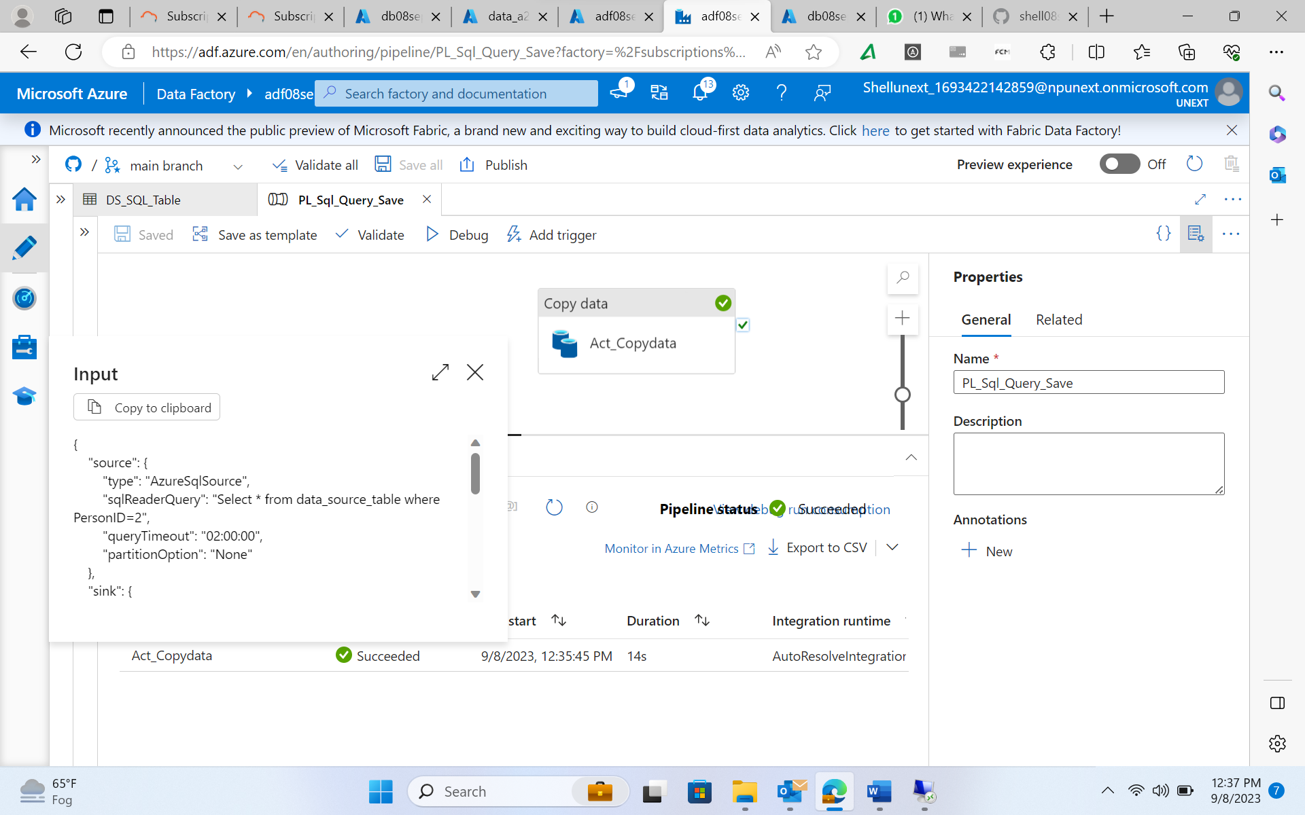
Day - 5 ( continued… )
2. Copy data activity from SQL Database to a container using SQL Query

Slide 19
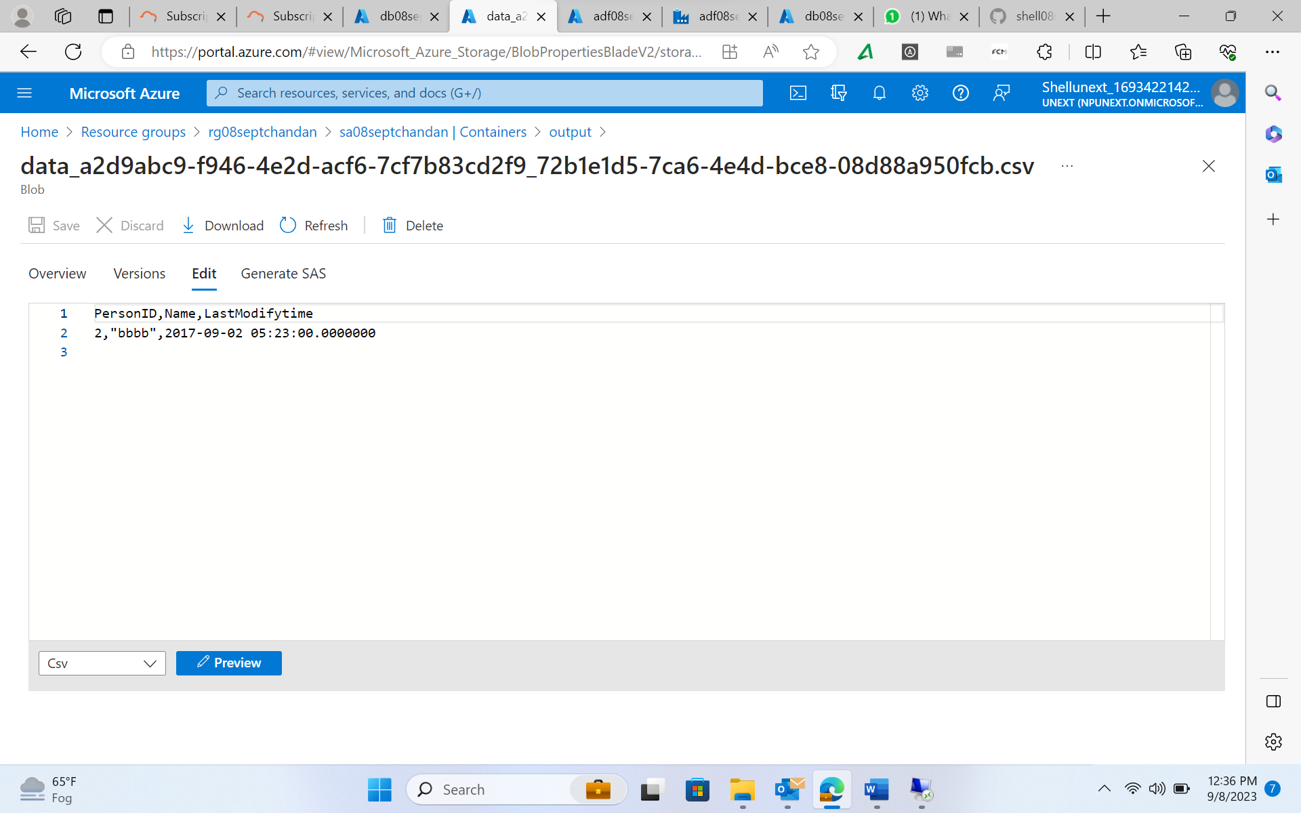
Day - 5 ( continued… )
Output of Copy data activity using SQL Query

Slide 20
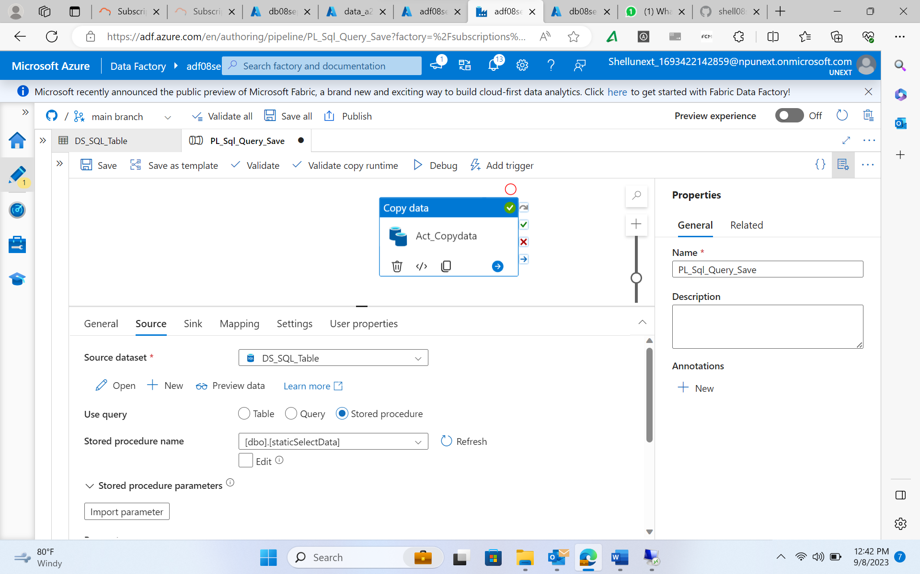
Day - 5 ( continued… )
3. Copy data activity from SQL Database to a container using Stored Procedure

Slide 21
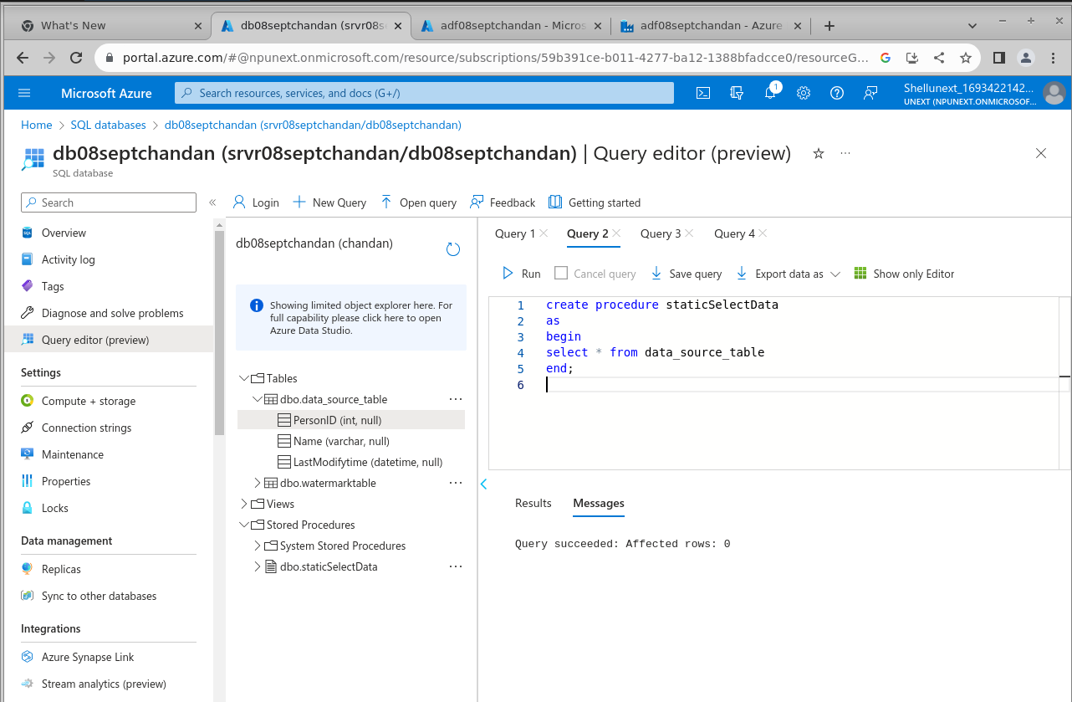
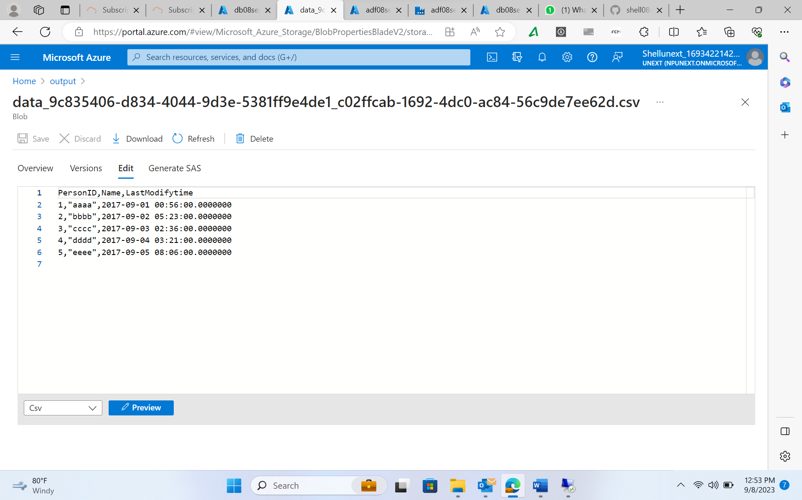
Day - 5 ( continued… )
Creating Stored Procedure
Output after running the pipeline

Slide 22
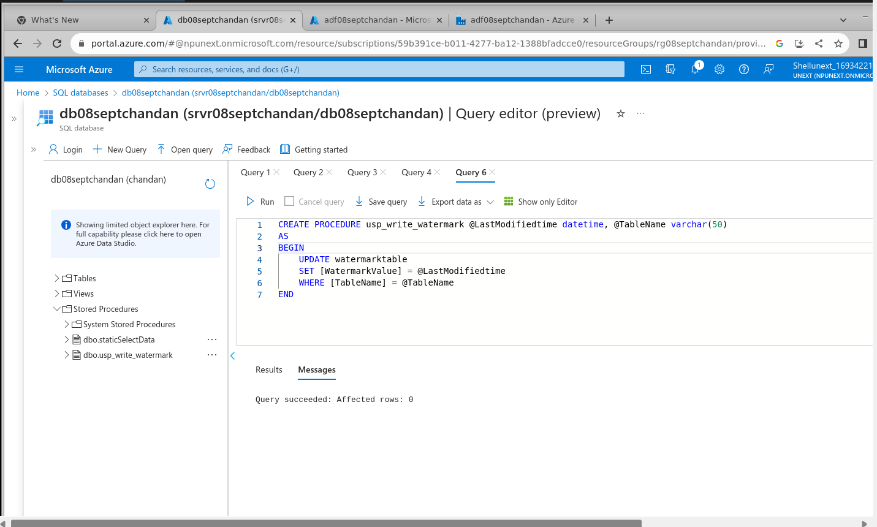
Day - 5 ( continued… )
4. Tracking changes in SQL database and copy data activity on change
This activity involves the creation of a watermark table to prevent any kind of override in the schema if some changes happen. After that we created two lookups i.e., old and new for monitoring of data modification and then copy data activity is carried out. On top of that storage procedure was carried out to execute predefined procedure.

Slide 23
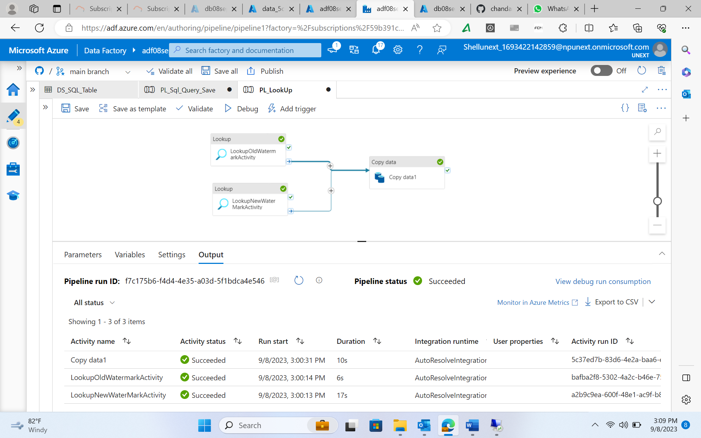
Day - 5 ( continued… )
Pipeline creation using lookup activities to query the database and copy on condition being satisfied

Slide 24
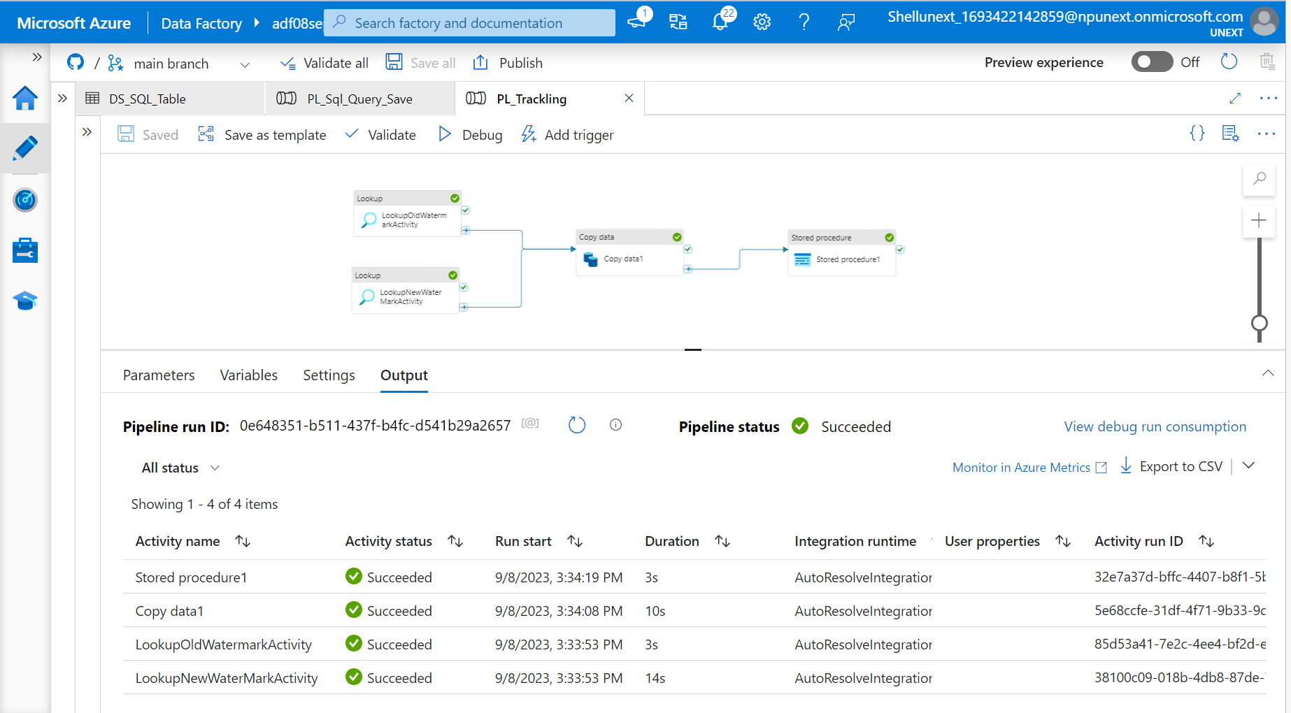
Day - 5 ( continued… )
Extending the pipeline by adding a stored procedure activity that runs on successful copy data activity to update certain table in the database.

Slide 25
Thank you

